Slide 1
Garment Industry Employee Productivity
Tijesunimi Odebode

Slide 2
Introduction
The garment industry is highly labor-intensive
The productivity of employees in garment manufacturing companies affects the ability of the companies to meet the global demand for garment products
If decision makers in the garment industry could analyze and predict employee productivity, this could help improve the overall production of garments and ultimately improve company revenue.
In this project, machine learning will be used to predict actual productivity of garment workers based on certain features in the garment manufacturing process
Rahim, M., Imran, A., & Ahmed, T. (2021). Mining the Productivity Data of Garment Industry. International Journal Of Business Intelligence And Data Mining, 1(1), 1. doi: 10.1504/ijbidm.2021.10028084

Slide 3
Data
date | department | day | team | targeted_ productivity | Over_time | incentive | #_of_workers | Actual_ productivity
2015-01-01 | sewing | Thursday | 8 | 0.80 | 7080 | 98 | 59.0 | 0.940725
2015-01-01 | finishing | Thursday | 1 | 0.75 | 960 | 0 | 8.0 | 0.886500
Table 1: A subset of the Original Garment Industry Employee Productivity Dataset
Table 1 is just a subset of the original dataset. Some rows and columns are not included
Data contains 15 columns and 1197 rows
Data Source: https://archive.ics.uci.edu/ml/datasets/Productivity+Prediction+of+Garment+Employees#

Slide 4
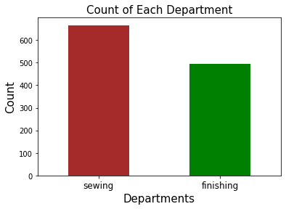
What departments were included in this study?
Figure 1: Departments included in Garment Industry Employee Productivity Dataset

Slide 5
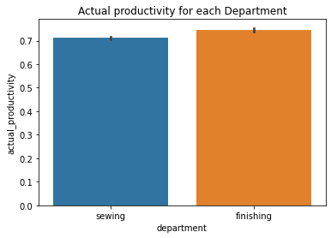
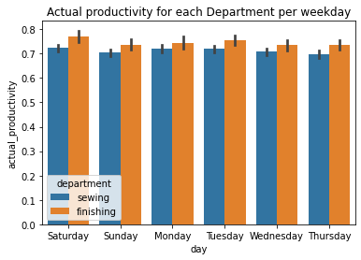
Actual Productivity for each department
Figure 2: Actual Productivity for each department
Figure 3: Actual Productivity for each department per weekday

Slide 6
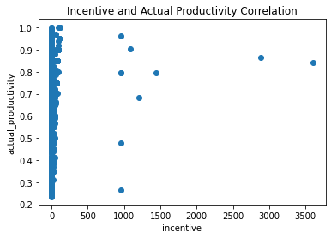
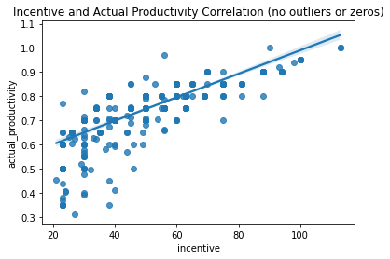
Correlation between Incentive and Actual Productivity
Figure 4: Incentive and Actual Productivity Correlation
Figure 5: Incentive and Actual Productivity Correlation
(no outliers or zeros)

Slide 7
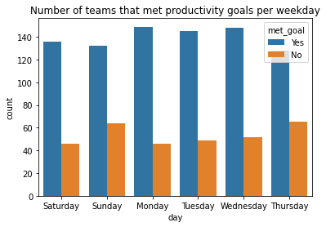
Teams that met productivity goals
team | targeted_productivity | actual_productivity
8 | 0.8 | 0.940725424
1 | 0.75 | 0.8865
11 | 0.8 | 0.800570492
team | targeted_productivity | met_goal
8 | 0.8 | Yes
1 | 0.75 | Yes
11 | 0.8 | Yes
Table 2: Subsets of the Original Garment Industry Employee
Productivity Dataset with new ‘met_goal’ column
Figure 6: Number of teams that met productivity goals
per weekday

Slide 8
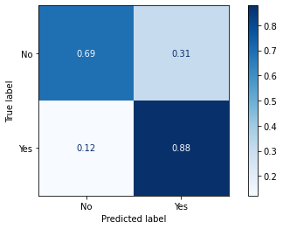
Model
Three models were created: Logistic Regression, KNN and Random Forest
I chose the Random Forest Model because it was the best model
True Negatives
False Positives
False Negatives
True Positives
Figure 7: Confusion Matrix for Random Forest Model
Note: This model can be further optimized for better results

Slide 9
Recommendations
The Random Forest model can help decision makers predict employees who are meeting or exceeding their targeted productivity. Employees who are not meeting their targeted productivity can also be predicted, but the model did not do very well with predicting those.
The Random Forest model may be useful in identifying employees who should be retained because they met or exceeded their targeted productivity. It can also be useful in determining those who might need to be given a warning or fired.
The Random Forest model can also be useful in identifying employees who might deserve a promotion or salary increase.
There was no correlation between incentive and actual productivity. However, when outliers and zero incentives were removed, there was a positive correlation. Maybe employers can consider giving more incentive to see if that would improve workers’ productivity

Slide 10
Thank You!
Email: tijesunimi@yahoo.com
LinkedIn: www.linkedin.com/in/tijesunimi-odebode-ms-phd
Github: https://github.com/todebode

